Slide 1
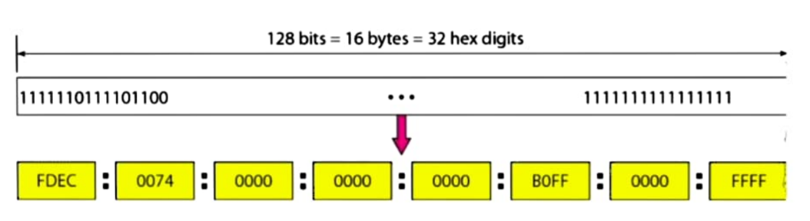
What is IPv6 address?
The system used for identifying and locating computers on the Internet.
Developed by the IETF.
128 address-address space of 2¹²⁸
bigger than IPv4.
Uses a Hexa-Decimal format
BY
GULSHAN KUMAR
DEVANAND S

Slide 2
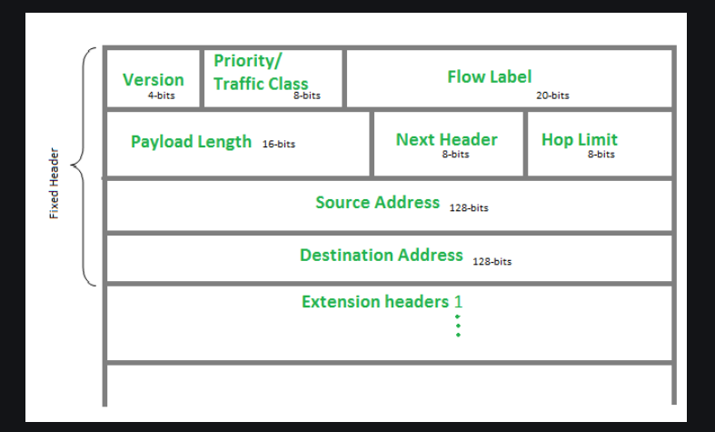
Header Format of IPv6:-
IPv6 Fixed Header:
The part of the information sent over the internet.
40 bytes
This helps devices talk to each other
Version (4-bits):
The size of this field is 4-bit.
It is always 6 for IPv6, so the bit sequence is 0110.
Traffic Class(8-bit):
It helps routers to handle the traffic.
If congestion occurs on the router then packets with the least priority will be discarded.

Slide 3
Flow Label (20-bits):
It is used by a source to label the packets belonging to the same flow.
It does not support the functionality of flow label field.
To specify the lifetime of the flow.
Payload Length (16-bits):
which tells routers about the amount of information a particular packet contains in its payload.
payload up to 65,535 bytes can be indicated with 16-bits.
Next Header (8-bits):
Indicates the type of extension header.
In some cases, it indicates the protocols contained within upper-layer packets.
Hop Limit (8-bits):
indicates the maximum number of intermediate nodes
This is used to discard the packets that are stuck in an infinite loop

Slide 4
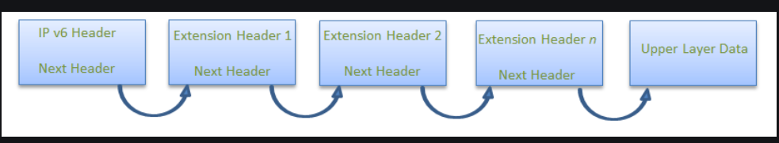
Address (128-bits)
Source Address (128-bits):
Source Address is the 128-bit IPv6 address of the original source of the packet.
Destination Address (128-bits):
indicates the IPv6 address of the final destination.
Intermediate nodes can use this information.
Extension Headers:
It is used to rectify the limitations of the IPv4,
important part of the IPv6 architecture.
The next Header field of IPv6 fixed header points to the first Extension field and so on.

Slide 5
THANK YOU!

